Slide 1
Chapter 7
Improving Decisions with Marketing Information
Notes:
For use only with Perreault/Cannon/McCarthy texts.
© 2019 McGraw-Hill Companies, Inc.
CHAPTER SEVEN
Lecture Notes for
Essentials of Marketing 16e

Slide 2
At the end of this presentation, you should be able to:
discuss marketing information systems.
understand the scientific approach to marketing research.
cite methods for collecting secondary and primary data.
understand the role of observing, questioning, and using experimental methods in marketing research.
Notes:
At the end of this presentation, you should be able to:
1. discuss marketing information systems.
2. understand the scientific approach to marketing research.
3. cite methods for collecting secondary and primary data.
4. understand the role of observing, questioning, and using experimental methods in marketing research.

Slide 3
At the end of this presentation, you should be able to:
understand the challenges to interpreting marketing research data.
recognize how market research information aids marketing planning in international markets.
understand important new terms.
Notes:
At the end of this presentation, you should be able to:
5. understand the challenges to interpreting marketing research data.
6. recognize how market research information aids marketing planning in international markets.
7. understand important new terms.

Slide 4
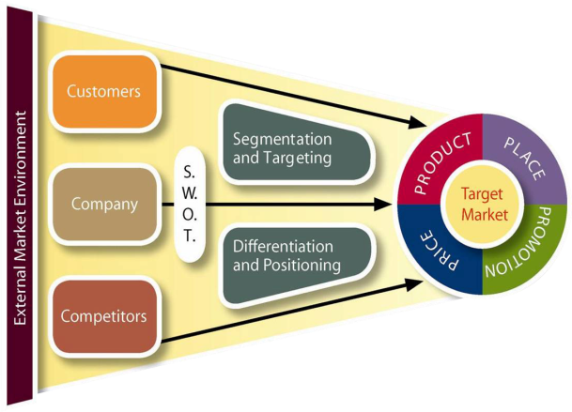
Marketing Information Inputs to Marketing Strategy Planning Decisions (Exhibit 7-1)
Information
for marketing
decisions
Data guides marketing strategy
Information sources
  External data
  Internal data
  Market research studies
  Big data
Marketing analysis
  Decision support systems
  Marketing models
  Predictive analytics
Marketing research
The scientific method
Steps in marketing research
  Define problem
  Analyze situation
  Gather problem-specific data
  Interpret the data
  Solve the problem
Notes:
Summary Overview
Two major elements relating to marketing information are: data and marketing research.
Key Issues
Data guides marketing strategy, and that data comes from a variety of sources.
Marketing research involves procedures that develop and analyze new information about a market.
Many firms rely on marketing research, whether in-house or contracted, to get answers to specific questions.
Discussion Question: Have you ever participated in a marketing research study? What information do you think the sponsor was trying to gather?

Slide 5

An MIS makes information available and accessible
Source: SAS Institute Inc.
Notes:
Text Caption: New software, like that sold by SAS, helps marketing managers analyze complex "big data."
Summary Overview
Marketing managers may need marketing research, an MIS, or a combination of both to get the information they need to make decisions during any step in the marketing strategy planning process.
Key Issues
Powerful intranets, computer software, and mobile devices like tablet computers and smartphones make it easier and less expensive for companies to gather, analyze, and access marketing information.

Slide 6

Marketing Information Systems Are Progressing
MIS makes information available and accessible
Decision support systems aid managers
“Big Data”
Information is easily accessible
From raw data to wisdom
©Shutterstock / Africa Studio
Notes:
Summary Overview
→ Marketing information systems (MIS) help make this information available and accessible.
Key Issues
An explosion of data is now available as organizations collect and store more information from internal sources, external sources, and market research studies.
Explosion is referred to as big data—or data sets too large and complex to work with typical database management tools.
All of that data may be stored in a data warehouse—a place where databases are stored so that they are available when needed.
Raw data is not particularly useful to a manager. Programs help convert the data to information, which can answer questions of “who?” “what?” “where?” and “when?” For example, a sales manager might pull a report that shows the last month’s sales for each of her salespeople, including how much they sold of each product to each major customer. That is information.
Information becomes knowledge when it helps a manager answer questions of how and why. Our sales manager may have to dig deeper than the previous report to find out why sales to Target stores in Oklahoma are down 10% last month.
As a manager gains experience, knowledge turns into wisdom and she can better predict the future.
Information is easily accessible with an intranet—a system for linking computers within a company or
A marketing manager may turn to a decision support system, a compute program that makes it easy to obtain and use information. Two type s of decision support systems are a marketing dashboard, which displays up-to-the-minute marketing data in an easy to read format like a car’s dashboard, or a marketing model, which is a statement of relationships among marketing variables. For example, a manager may have a model that shows how much sales will increase with an increase in advertising spending.
Discussion Question: What advantages would an organization have over its competitors if it had a superior marketing information system?
→ Indicates place where slide “builds” to include the corresponding point (upon mouse click).

Slide 7
Elements of a Marketing Information System (Exhibit 7-2)
Information sources
Data storage and access
MIS
Results
Marketing analysis
Marketing strategy planning process and strategy decisions
Notes:
Summary Overview
A good MIS stores data collected from inside and outside the company and from various marketing research studies. The data can be analyzed to guide the marketing strategy planning process.
Key Issues
Here are the elements of a marketing information system:
Information sources. These include internal data, external data, and marketing research studies.
Data storage and access. This includes the data warehouse and a search engine for access.
Marketing analysis. This include decision support systems, including dashboards, marketing models, and predictive analytics.
Marketing strategy planning process and strategy decision.
Results. Including marketing metrics such as profits, market share, and customer lifetime value.
→ Indicates place where slide “builds” to include the corresponding point (upon mouse click).

Slide 8

Research Is a Bridge to Customers
Click on play button to view video
Notes:
Marketing research is a set of procedures to develop and analyze new information to help marketing managers make decisions. Marketing researchers get facts that aren’t available in the MIS. This ad from Quiznos, though humorous, illustrates the importance of marketing research and how flawed research can lead to inaccurate conclusions.
Video Operation:
INTERNET CONNECTION REQUIRED
Clicking on the orange circle image will open a web browser and access this video. When the video is completed, you can close or minimize the browser and return to the PowerPoint slides.

Slide 9
Five-Step Scientific Approach to Marketing Research Process (Exhibit 7-3)
Defining the problem
Analyzing the situation
Early identification of solution
Feedback to previous steps
Getting problem-specific data
Interpreting the data
Solving the problem
Notes:
Summary Overview
An MIS typically makes use of regularly collected recurring information, but marketing research develops unique information to solve a new problem.
Key Issues
Scientific method: a decision-making approach that is objective and orderly in testing ideas before accepting them.
Hypotheses: educated guesses about likely causes and effects that can be measured objectively to help eliminate unnecessary risk taking.
Marketing research process: a five-step application of the scientific method:
Step 1 is defining the problem: the manager and the researcher determine the key decision issues requiring information.
→ Step 2 is analyzing the situation: an informal study of information that is already available in the problem area.
→ Step 3 is getting problem-specific data: the collection of data that is customized to the decision maker’s unique needs.
→ Step 4 is interpreting the data: the process of getting meaning from the collected data; it is a transformation of raw data to useful information.
→ Step 5 is solving the problem: the delivery of recommendations to the marketing manager, who is ultimately responsible for implementing the recommendations.
→ The process may move in the step by step process outlined here—or as the feedback arrows show, the researcher may learn something in the process that moves them back to an earlier step in the process.
The marketing manager may find that at any step, a solution might be identified—the early identification of a solution can save time and money.
Discussion Question: How does an approach like the marketing research process help research to be systematic (well-planned), objective, and oriented toward the needs of managers?
Good marketing research requires cooperation between researchers and marketing managers.
Researchers must be sure their research focuses on real problems.
→ Indicates place where slide “builds” to include the corresponding point (upon mouse click).

Slide 10

Defining the Problem—Step 1
Finding the Right Problem Level
Problems vs. Symptoms
©Purestock/Getty Images
Setting Research Objectives
Notes:
Summary Overview
This is the most important and often the most difficult step in the research process. Often, the researcher must help the manager to flesh out the real problem facing the organization and the types of information needed to solve the problem.
Key Issues
→ Finding the right problem level almost solves the problem, in many cases.
In order to find the right problem, the marketing strategy planning framework can be useful.
→ Don’t confuse problems with symptoms.
Key performance indicators in marketing may be symptoms of other more fundamental problems.
Discussion Question: Suppose a firm experiences a sudden sales decline. Is this decline a symptom or a problem? Why?
→ Setting research objectives may require more understanding.
The researcher and manager can develop a list of research questions that are most important.
A single research project may not be adequate for answering all of the questions.
→ Indicates place where slide “builds” to include the corresponding point (upon mouse click).

Slide 11

Analyzing the Situation—Step 2
What information do we already have?
©Shutterstock / Mmaxer
Situation analysis helps educate a researcher
Notes:
Summary Overview
Situation analysis is basically an informal study in answer to the question, → “What information do we already have in the problem area.”
Key Issues
→ Situation analysis helps educate a researcher, by providing background about unfamiliar problem areas.
The situation analysis may uncover information that leads to an early identification of a solution, or it may help to determine what other types of information are really necessary.
→ Indicates place where slide “builds” to include the corresponding point (upon mouse click).

Slide 12
Sources of Secondary and Primary Data (Exhibit 7-4)
Company sales and cost data by product, channel, or geographic region. Previously published marketing research studies.
Inside company
Secondary data
Search the Internet, library and government databases. Talk to researchers at universities and private research organizations.
Outside company
All data sources
Video of customers shopping. Track consumer clicks on a website. Loyalty card data from retailers
Observation
Primary data
Focus group or in-depth interviews with customers to learn their needs. Online, phone, or personal interview surveys of customers to measure customer satisfaction.
Questioning
Notes:
Summary Overview
A situation analysis usually incorporates secondary data, which may provide the answers, or at least some background, relevant to the research problem.
Key Issues
→ Secondary data: information that has already been collected or published.
→ Primary data: information specifically collected to solve a current problem.
We will start our discussion with a focus on secondary data sources before moving into a discussion of primary data.
→ Much secondary data is available.
Examples of secondary data sources from inside the company might be data from the MIS, financial information from the accounting department, or reports from the field sales force.
Information from outside the company might include government information, trade association studies, or information available in magazines or journal articles.
Search the Internet for information.
Search engines may miss important databases available on the Internet.
Special interest discussion groups or newsgroups on the Web share information on topics of specific interest.
Government data is inexpensive and available in digital or printed form. Most countries with advanced economies have government agencies that help researchers get the data they need.
Discussion Question: Why does it make sense to examine secondary data first, before gathering primary data?
→ Primary data may be obtained through observation or questioning. We will look at these sources of data in more detail next.
→ Indicates place where slide “builds” to include the corresponding point (upon mouse click).

Slide 13
Checking Your Knowledge
Edna Bates, a marketing researcher who is an expert in customer satisfaction research, is asked by a client to conduct a study dealing with a completely unfamiliar research topic. Edna consults secondary data to gain more insight about this unfamiliar area. Edna is engaged in the _________ stage of the marketing research process.
A. problem definition
B. situation analysis
C. gathering problem-specific data
D. data interpretation
E. solving the problem
Notes:
Checking Your Knowledge
Answer: B
Feedback: In the above question, Edna is investigating information already available in the customer satisfaction field. She is engaged in the situation analysis (an informal study of what information is already available in the problem area) stage of the marketing research process. The best answer selection is B.

Slide 14
The Bottom Line on
Secondary Data
Key
Issues
Situation Analysis: a Lot for a Little
What Else Is Needed?
Research Proposal
Notes:
Summary Overview
Regardless of the source, it makes sense to examine secondary information before collecting more customized primary data, because secondary data tends to be relatively inexpensive and easy to acquire. Therefore, → situation analysis yields a lot, for very little.
Key Issues
→ The small amount of time and money spent on reviewing secondary data may actually solve the research problem, or:
it can help to establish research priorities;
focus the research objectives more precisely; or
suggest additional issues for examination.
The outcome of a situation analysis is a listing of the research questions that remain unanswered.
→ At this point, the researcher can determine what else is needed and how to get it.
→ Research proposal: a plan that specifies what information will be obtained and how.
The research proposal helps to keep a research project on track and on budget.
Discussion Question: Other than control over budgeting and project scheduling, what other advantages does a research proposal provide for both researchers and managers?
→ Indicates place where slide “builds” to include the corresponding point (upon mouse click).

Slide 15
Getting Problem-Specific Data—Step 3
Primary
Data
Observing
Questioning
Notes:
Summary Overview
In getting problem-specific data, marketers collect primary data that is customized to their unique needs. In most cases, researchers try to learn what customers think about a particular topic, or they try to see how they behave under certain conditions.
Key Issues
There are two basic methods of collecting primary data:
Observing
→ Questioning
It can range from qualitative to quantitative research.
Qualitative research seeks in-depth, open-ended responses, not yes or no answers. The researcher tries to get people to share their thoughts on a topic—without giving them many directions or guidelines about what to say.
The depth of the qualitative approach gets at the details—even if the researcher needs a lot of judgment to summarize it all.
Quantitative research seeks structured responses that can be summarized in numbers, such as percentages, averages, or other statistics.
For example, a marketing researcher might calculate what percentage of respondents have tried a new product and then figure an average score for how satisfied they were.
Discussion Question: If the depth of responses is a key advantage of qualitative questioning, what might be a disadvantage?
→ Indicates place where slide “builds” to include the corresponding point (upon mouse click).

Slide 16

Focus Groups Stimulate Discussion
Source: FocusVision Research Inc.
Notes:
Text Caption: FocusVision Research is a marketing research provider that offers both qualitative and quantitative (Q+Q) research. Qualitative research offers more depth, while quantitative research provides more representative samples and objective measures to test hypotheses.
Summary Overview
One of the most popular forms of qualitative questioning is the focus group.
Key Issues
Focus group interview: involves interviewing 6 to 10 people in an informal group setting. A skilled moderator leads the discussion, asking open-ended questions on topics of interest and taking advantage of group dynamics to pursue comments in-depth. Sessions are usually videotaped, or they may be broadcast via Internet or satellite.
Focus group interviewing can be relatively inexpensive, and it can be conducted quickly. However, the conclusions drawn from a focus group depend on who watches it. Focus groups involve so few people as participants that they may not be representative of the entire target market.
Focus groups can also be overused and mistaken for “market facts.” Sometimes, they generate more questions than answers. As a result, many researchers use focus groups as preparation for more formal quantitative research utilizing a larger, scientifically selected group of respondents.
Discussion Question: Have you ever participated in a focus group? Describe your experience.

Slide 17
Structured Questioning Gives More Objective Results
Seeks structured responses
Can be summarized in numbers
Quantitative
Research
Faster response & analysis
Notes:
Summary Overview
If the collection of primary data is standardized, there are several advantages for researchers. They can use identical questions and response alternatives across a large, representative sample of respondents. They can also summarize the information using a variety of statistics.
Key Issues
Quantitative research seeks structured responses → that can be summarized in numbers, such as percentages, averages, or other statistics.
→ Fixed responses speed answering and analysis. For example, a common approach is to have consumers indicate how much they agree or disagree with a statement on a survey.
Discussion Question: If you were trying to decide whether to execute a $30 million advertising campaign, would you rather base your decision on qualitative or quantitative research? Why?
→ Indicates place where slide “builds” to include the corresponding point (upon mouse click).

Slide 18
Checking Your Knowledge
A sales training firm wants feedback on the quality of its classes and training services. The firm planned to send mail surveys to CEOs of its client companies to get the needed information. However, one executive objected to the survey plan, saying, “CEOs don’t attend our classes. How will they know if the classes are any good?” Another executive added, “If the survey isn’t relevant to the CEOs, it will be thrown away and we’ll get no data.” It appears that the research design presents problems with:
A. response rate.
B. relevance of population.
C. validity.
D. improper statistical analysis.
E. both A and B.
Notes:
Checking Your Knowledge
Answer: E
Feedback: Low response rate is a common problem in mail surveys. Response rates are likely to be even lower if people who receive the questionnaire are not interested in or knowledgeable about the questions. This research design is marked with at least two problems: (1) low response rate and (2) relevance of the population (if the CEOs don’t even attend the classes). The best answer selection is E because both A and B are problems.

Slide 19
Surveys Come in Many Forms
Mail and Online
Primary
Methods
for
Collecting
Survey
Data
Telephone
Personal Interview
Notes:
Summary Overview
There are several different types of surveys. The choice of the right survey depends on the research objectives and constraints such as time and money.
Key Issues
→ Mail and online surveys are common and convenient. Advantages of these types of surveys include the ability to ask an extensive set of questions; convenience for the respondent; anonymity; and a greater willingness by the respondent to provide personal information.
The main disadvantage is a low response rate—the percentage of people contacted who complete the survey. It may also take a long time to get the results. Recently, more researchers have been delivering surveys faster online.
Discussion Question: How might online survey respondents be different than the population in general? What impact would these differences have on the results of a survey and the conclusions that a researcher might draw from it?
→ Telephone surveys are fast and effective. Researchers can gather data more quickly and prepare it for analysis faster than with a mail survey, and there is an opportunity for researchers to probe respondents for details. However, telephone surveys are more costly and may inconvenience respondents.
→ Personal interview surveys can be in-depth, and give the interviewer the chance to explain complex issues. Interviewers must be well trained to avoid biasing the respondents’ answers. Consumer interviews are often done in shopping malls or retail stores, but interviews are even more expensive than telephone surveys.
→ Indicates place where slide “builds” to include the corresponding point (upon mouse click).

Slide 20
Checking Your Knowledge
A researcher wants to study 1,000 consumers and needs information about a lot of personal and sensitive issues. Which of the following would be the best way to gather this information?
A. Mail survey
B. Focus group
C. Telephone survey
D. Face-to-face interview
E. Experiment
Notes:
Checking Your Knowledge
Answer: A
Feedback: Mail surveys are particularly useful when you intend to contact a large number of consumers. In the above question, the researcher would like to contact 1,000 consumers and wants to gather personal and sensitive information. This is best handled through a mail questionnaire since it can be completed anonymously. The best answer selection is A.

Slide 21
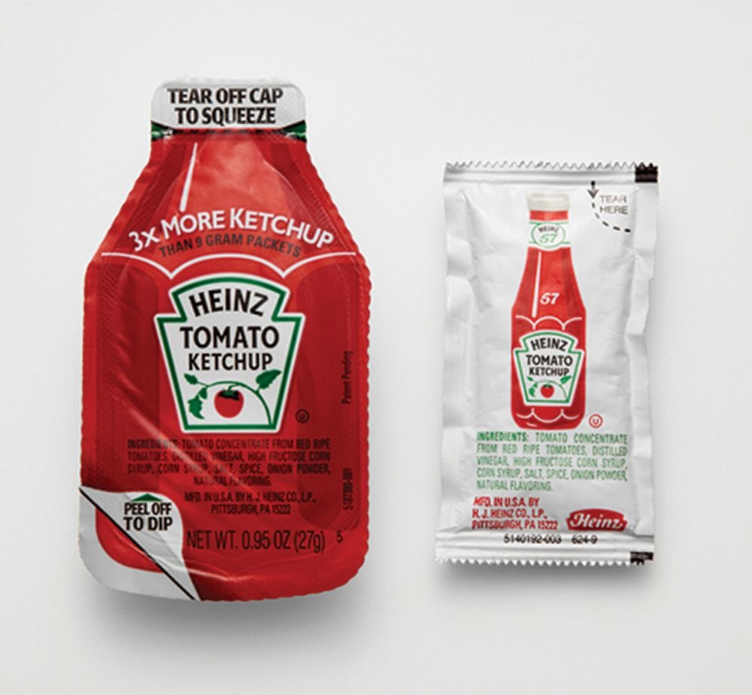
Other Market Research
MROCs
Questioning
Observing
Ethnographic
©Fortunato M. Ramin Photography
Notes:
Text Content: See below.
Summary Section
There are several other options for market research, each with pluses and minuses.
A market research online community (MROC) is recruited to fit a desired psychographic, lifestyle, or demographic profile and may be comprised of 50 to several hundred members. Members spend months, possibly years, online together brainstorming ideas and conversing with other customers and the firm’s marketing managers.
Questioning—whether qualitative or quantitative—has its limitations. Respondents sometimes give answers that they think the questioner wants to hear, or they may not accurately recall past events.
With the observation method, researchers try to see or record what the subject does without influencing the subject’s behavior.
Ethnographic research has its roots in anthropology, which studies different cultures by observing participants in their natural habitat: in their homes or at work.
For example, marketing managers for Heinz Ketchup knew they had an opportunity if they could make it easier to eat French fries while driving. To learn more, marketing managers sat behind a one-way mirror and watched consumers sitting in minivans put ketchup on fries, burgers, and chicken nuggets during a simulated driving experience. They saw some people tear the corners off packets with their teeth and others squirt ketchup in their mouth before adding fries. Insights from this research fueled development of Heinz “Dip and Squeeze” ketchup packets, which can be squeezed from one end like the traditional foil pouch or opened by peeling back the lid, for those who prefer dipping. Consumers like the new packaging and fast-food restaurants are selling more French fries out of the drive-through window.
→ Indicates place where slide “builds” to include the corresponding point (upon mouse click).

Slide 22

Observing—What You See Is What You Get
Observation Is Common in Advertising Research
Web Site Analysis
©Shutterstock / Zoriana Zaitseva
Checkout Scanners “See” A Lot
Consumer Panels
Notes:
Summary Overview
Observing is another way to collect primary data. It focuses on a well defined problem.
Sometimes the best way to observe a customer is for the marketing manager to become a customer.
Key Issues
In observation research, researchers try to see or record the behaviors of people. Most observation is done without the knowledge of the people being observed, because researchers do not want to influence the things people do. Observation can be done by humans or by machines.
→ Observation methods are common in advertising research.
Nielsen Media Research gathers data on television viewership by using “people meters” that record the channels watched by a selected sample of consumers.
Website analysis software allows marketing managers to observe customer behavior at a firm’s website.
Discussion Question: The data for developing TV ratings used to be collected exclusively via “diaries”—paper-and-pencil logs in which consumers recorded the programs they watched. Would you expect to see differences between what people recorded in a viewing diary compared to what a people meter might show? What types of differences?
→ Checkout scanners “see” a lot, as well, when it comes to shopping behavior.
This information helps retailers to manage their inventories and adjust their merchandise selections.
→ Consumer panels are groups of consumers who provide information to research firms on a continuing basis.
This information is made available to clients for a fee.
→ Indicates place where slide “builds” to include the corresponding point (upon mouse click).

Slide 23
Illustration of Experimental Method in Comparing Effectiveness of Two Ads (Exhibit 7-5)
Difference in response between two groups
Groups of people are similar except for the ad they see
Half of the people see Ad #1
Average for group who saw Ad #1 = 3.2
Representative group of customers
Half of the people see Ad #2
Average for group
who saw Ad #2 = 4.6
1
2
3
4
5
Average product interest rating by group
Notes:
Summary Overview
Questioning and observing might also be used in a different way by incorporating them into an experimental method, in which researchers compare the responses of two or more groups that are similar, except on the characteristic being tested.
Key Issues
Suppose a researcher wants to compare the effectiveness of two different versions of an ad. The effectiveness could be measured by the response of consumers to a question about their interest in the advertised product.
→In step 1: researchers select a representative group of consumers.
→ In step 2: researchers then randomly split the group in two, and each group sees a different ad.
→ In step 3: researchers ask consumers to rate their level of interest in the product advertised. So, let’s say the group viewing Ad #1 has an average interest in the product—after watching the ad—of 3.2 on a 5-point scale with 5 indicating very interested.
And the people who saw Ad #2 had a more favorable impression. This group rated their interest in the product as 4.6 on the 5-point scale.
Discussion Question: What conclusions can be drawn from this research?
The researchers conclude that the higher rated ad causes people to have greater interest in the product than does the lower rated ad.
Test marketing is another way to experiment. Researchers can select geographic areas in which they vary a product’s marketing mix in some way, and then they compare the results across the geographic areas. For example, a candy company might compare two different packages for a new candy bar. The company could introduce one package design in Syracuse, New York, and a second package design in Omaha, Nebraska—and then compare the sales in the two test markets.
Syndicated research shares data collection costs.
A combination of research methods may be needed.
Understand the costs and benefits of research.
→ Indicates place where slide “builds” to include the corresponding point (upon mouse click).

Slide 24
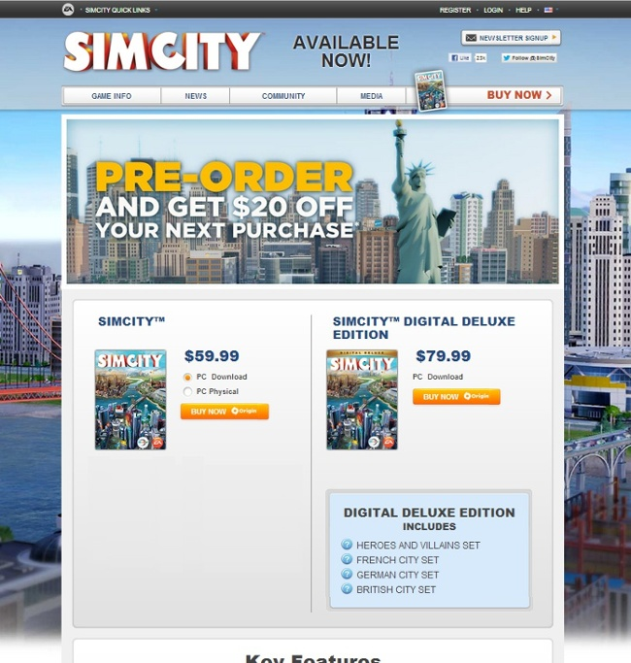
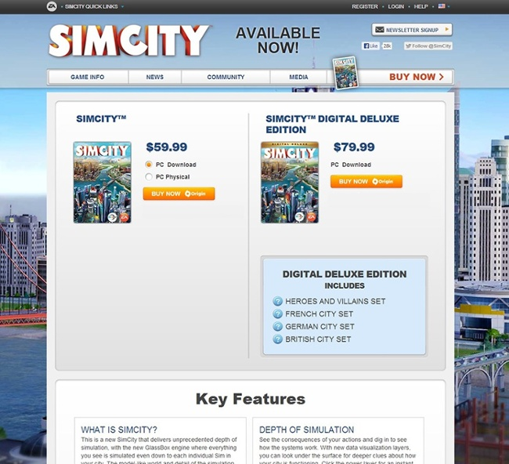
Which web page sells more games?
Version A
Version B
From Hubspot: https://blog.hubspot.com/marketing/a-b-testing-experiments-examples
Notes:
Summary Overview
A/B testing provides marketing managers with insights.
Key Issues
When Electronic Arts launched SimCity 5, it wanted to maximize revenue.
Discussion Question: Which web page do you think generated more game sales?
When Electronic Arts pre-laucned SimCity 5, it used the special offer listed in Version A. But sales were not meeting expectations. So EA tested some variations, including version B which removed the special price promotion. Surprisingly, version B generated 43% more game purchases. While sales promotion often drives sales – in this case, at launch, customers just wanted to guy the game and needed no extra incentive to do it. In fact, the promotion may have distracted customers from their primary goal – upgrading to the new version of the game. (for more details see https://blog.hubspot.com/marketing/a-b-testing-experiments-examples)

Slide 25
Key Concerns in Data Interpretation—Step 4
Population
Sample
Key
Issues
Validity
Confidence Intervals
Notes:
Summary Overview
Statistical packages (easy-to-use computer programs that analyze data) have made interpreting data easier. Cross-tabulation is one of the most frequently used approaches for analyzing and interpreting marketing research data.
Certain basic issues are critical in assessing the quality of a research project.
Key Issues
The first question a marketing researcher must answer is, “Is your sample truly representative of the population?”
Population: the total group of interest to the researcher or marketing manager
→ Sample: a smaller group selected to represent the population
The key here is to ensure that the sample selected represents the larger population.
Discussion Question: Is a metropolitan area’s telephone directory a complete list of that area’s population? Why or why not? What implications are there for researchers who want to select samples of consumers from the telephone book?
Chatter on the Internet—not representative but can be useful.
→ Research results are not exact.
Confidence interval: the range on either side of an estimate that is likely to contain the true population value.
→ Validity problems can destroy research.
Validity: the extent to which data measures what it is intended to measure.
Poor interpretation can also destroy research.
Problems can arise if the researcher does not understand the management problem, so the marketing manager and researcher should work together closely.
Ethics involved in interpreting and presenting results.
The most common ethical issues concern decisions to withhold certain information about the research.
→ Indicates place where slide “builds” to include the corresponding point (upon mouse click).

Slide 26
Ethical Issues in Marketing
Click on play button to view video
Notes:
This video clip illustrates an ethical issue between Coke and Burger King.
(video length 0.57)
Video Operation:
INTERNET CONNECTION REQUIRED
Clicking on the orange circle image will open a web browser and access this video. When the video is completed, you can close or minimize the browser and return to the PowerPoint slides.

Slide 27
Checking Your Knowledge
A marketing research firm conducted a telephone survey for a consumer products company. It provided new and interesting information about brand image, the competition, and other topics. At the end of the research company’s results presentation, the sales manager commented, “This is all interesting information, but it doesn’t tell me why our market share is declining among 18 to 34 year old women, nor does it offer me any suggestions about actions I can take to deal with the situation.” The sales manager’s complaint suggests that the research suffers from problems with:
A. a lack of action implications for management.
B. poor planning by the researcher and managers at the outset of the project.
C. poor sampling.
D. a low response rate.
E. both A and B.
Notes:
Checking Your Knowledge
Answer: E
Feedback: The sales manager is left with questions because the research (1) lacked proper planning at the outset of the project to correctly define the problem and (2) didn’t result in actionable implications for management. The best answer selection is E because both A and B describe problems with the current situation.

Slide 28

Solving the Problem—Step 5
Interesting Tidbits
No Action Implications—Little Value
©lianna2013/123RF
Application in Marketing Strategy Planning
Evaluate
Notes:
Summary Overview
In this last step of the research process, managers use the research results to make marketing decisions.
Key Issues
Researchers and managers are fascinated by the interesting tidbits of information that come from the research process. They are excited if the research reveals something they didn’t know before.
→ If research doesn’t have action implications, it has little value and suggests poor planning by the researcher and the manager.
→ When the research process is finished, the marketing manager should be able to apply the findings in marketing strategy planning—the choice of a target market or the mix of the four Ps.
→ If the research doesn’t provide information to help guide these decisions, the company has wasted research time and money.
→ Indicates place where slide “builds” to include the corresponding point (upon mouse click).

Slide 29

International Marketing Research
Research Contributes to Success
Accurate Data—Hard to Find?
Coordinate and Standardize
Avoid Mistakes with Local Researcher
©sankai/Getty Images
Notes:
Summary Overview
Marketing research contributes to international marketing success. Customer needs and interests, as well as segmenting dimensions and other environmental factors, may be considerably different in foreign markets. Decisions made without sound marketing research are laden with risk.
Key Issues
→ In many countries it is difficult for a foreigner to gather accurate information.
Marketers dealing in international markets would be well advised to avoid mistakes by using local researchers.
Discussion Question: Why is it advisable to use overseas market researchers in investigating foreign markets?
→ If a firm is engaged in similar research projects in various overseas markets, some coordination and standardization makes sense.
→ Indicates place where slide “builds” to include the corresponding point (upon mouse click).

Slide 30
Marketing Research Identifies International Opportunities
Click on play button to view video
Notes:
P&G utilized market research to develop and grow the teeth whitening category. To grow the market internationally, P&G conducted market research about teeth whitening in many other countries around the world. It found a need for whiter teeth also existed in the United Arab Emirates—this ad for Crest Whitening Toothpaste is from that market.
Video Operation:
INTERNET CONNECTION REQUIRED
Clicking on the orange circle image will open a web browser and access this video. When the video is completed, you can close or minimize the browser and return to the PowerPoint slides.

Slide 31
Key Terms
marketing research
marketing information system (MIS)
big data
data warehouse
decision support system (DSS)
marketing dashboard
marketing model
scientific method
hypotheses
marketing research process
situation analysis
secondary data
primary data
sentiment analysis
research proposal
qualitative research
customer journey map
…..
Notes:
Summary Overview
These are key terms you should be familiar with based upon the material in this presentation.
Key Issues
Marketing research: procedures to develop and analyze new information to help marketing managers make decisions.
Marketing information system (MIS): an organized way of continually gathering, accessing, and analyzing information that marketing managers need to make decisions.
Big Data: Data sets too large and complex to work with typical database management tools.
Data warehouse: a place where databases are stored so that they are available where needed.
Decision support system (DSS): a computer program that makes it easy for marketing managers to get and use information as they are making decisions.
Marketing dashboard: a computer display of up-to-the-minute marketing data in an easy-to-read format customized to the manager’s area of responsibility.
Marketing model: a statement of relationships among marketing variables.
Scientific method: a decision‑making approach that focuses on being objective and orderly in testing ideas before accepting them.
Hypotheses: educated guesses about the relationships between things or about what will happen in the future.
Marketing research process: a five‑step application of the scientific method that includes: (1) defining the problem, (2) analyzing the situation, (3) getting problem-specific data, (4) interpreting the data, and (5) solving the problem.
Situation analysis: an informal study of what information is already available in the problem area.
Secondary data: information that has been collected or published already.
Primary data: information specifically collected to solve a current problem.
Sentiment analysis: an automated process of analyzing and categorizing social media to determine the amount of positive, negative, and neutral online comments a brand receives.
Research proposal: a plan that specifies what marketing research information will be obtained and how.
Qualitative research: seeks in‑depth, open‑ended responses, not yes or no answers.
Customer journey map: the story and graphic diagram of a customer’s experience in the buying process from need awareness through the purchase process and post-purchase relationship.
This slide refers to boldfaced terms appearing in Chapter 7.

Slide 32
Key Terms
focus group interview
quantitative research
response rate
consumer panel
experimental method
statistical packages
population
sample
confidence interval
validity
Notes:
Summary Overview
These are additional key terms.
Key Issues
Focus group interview: an interview of 6 to 10 people in an informal group setting.
Quantitative research: seeks structured responses that can be summarized in numbers—like percentages, averages, or other statistics.
Response rate: the percent of people contacted in a research sample who complete the questionnaire.
Consumer panels: a group of consumers who provide information on a continuing basis.
Experimental method: a research approach in which researchers compare the responses of two or more groups that are similar except on the characteristic being tested.
Statistical packages: easy‑to‑use computer programs that analyze data.
Population: in marketing research, the total group you are interested in.
Sample: a part of the relevant population.
Confidence interval: the range on either side of an estimate from a sample that is likely to contain the true value for the whole population.
Validity: the extent to which data measures what it is intended to measure.
This slide refers to boldfaced terms appearing in Chapter 7.

